Slide 1
The Battle of Neighborhoods in Tokyo, Japan
Kevin Goh
IBM DATA SCIENCE CAPSTONE, Jun 2021

Slide 2
INTRODUCTION
As a businessman looking to start a business in a foreign city, one has to understand where the underlying demand lies among several neighborhoods in the city.
One such city which we are keen to study is Tokyo, which has over 100 neighborhoods, each with different commuters and residents.

Slide 3
DATA
We will identify the neighborhoods of Tokyo using the Wikipedia page: https://en.wikipedia.org/wiki/Template:Neighborhoods_of_Tokyo
Using Foursquare’s API, we will get the latitude, longitude as well as the top venues in each neighborhood.

Slide 4
METHODOLOGY
The Wikipedia page https://en.wikipedia.org/wiki/Template:Neighborhoods_of_Tokyo will be scraped using the BeautifulSoup library to build a Pandas dataframe listing the neighborhoods in Tokyo.
The Foursquare API is then used to get the associated venues and rank the venues according to which is most common.

Slide 5
CLASSIFICATION
K-Means algorithm will be used to cluster the neighborhoods and to identify common venues within the neighborhoods
We will identify the clusters and the applicable businesses that we can start which commuters and residents commonly patronize

Slide 6
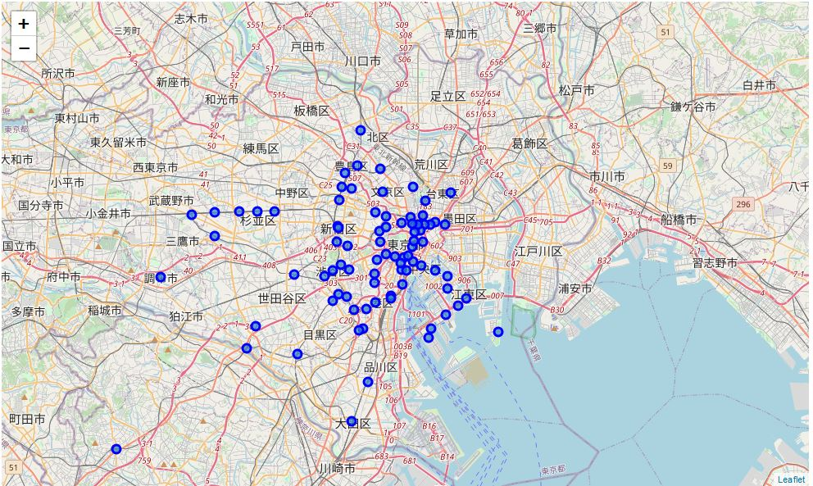
DESIRED START MAP

Slide 7
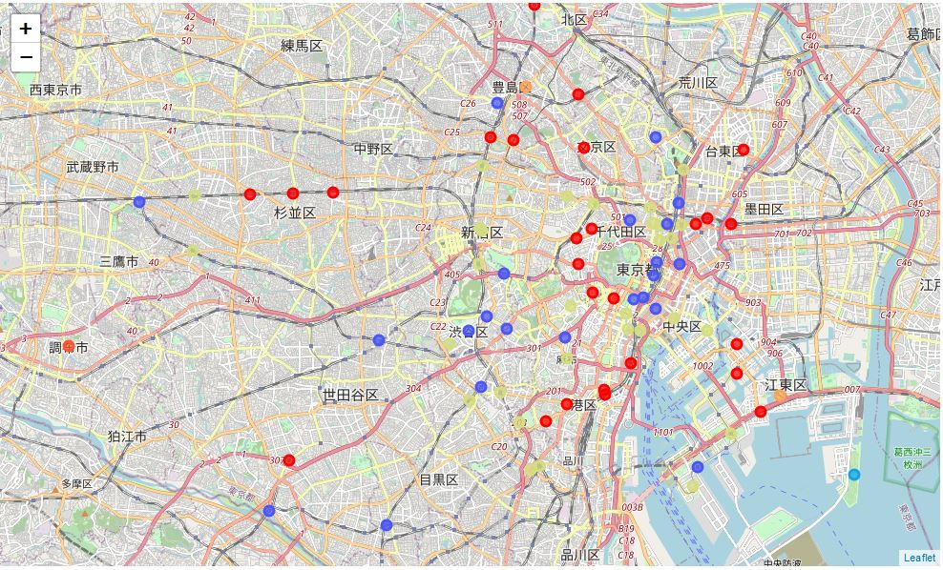
DESIRED END MAP

